Slide 1
Statistical Analysis
t-distribution

Slide 2
A new distribution
We have used the normal tables in hypotheses testing and estimation up to now.
We really should have been using the t-distribution
Just another theoretical distribution that we need to know about it.
Horrendous mathematical formula.

Slide 3
The t-distribution
It is a theoretical distribution
Unlike the normal distribution it has a different shape for different sample sizes
Degrees of freedom = n-1
Invented here in Dublin to cater for small sample sizes by Gosset who used work in the Guinness brewery
Students t-distribution

Slide 4
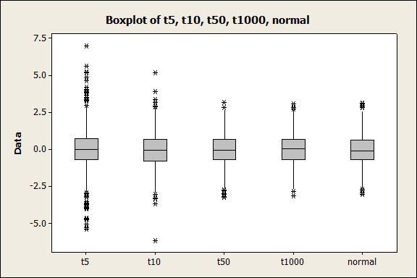
Graph of t-distribution

Slide 5
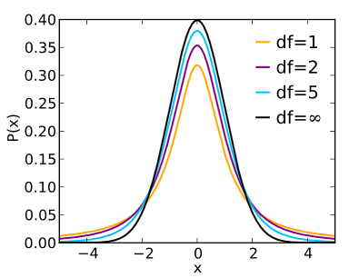
Another picture

Slide 6
How do we use the t-distribution?
We use the tables to decide on critical values when we are doing hypothesis testing
We also use it for our confidence intervals.
Look up the tables
Significance level α
n=25, df=n-1=24
α= 0.05 critical value = 2.06
We would use that to construct a 95% CI instead of 1.96

